Slide 1
Predicting Liquor Sales in Iowa
Identifying regions for growth and using 2015 data to extrapolate to 2016
Scott Levin
February, 2018

Slide 2
Summary
Liquor sales are projected to increase by ~4% for the 2016 fiscal year.
This should lead to approximately $9.7 million dollars in additional sales compared to 2015, or $253.3 million in total revenue.
Worst case scenario $247.3 million, best case $259.3.
Examining predicted stores and profit- Story County appears to be a great candidate for store expansion. Our model estimates it to be supporting 28 more stores than it currently does.

Slide 3
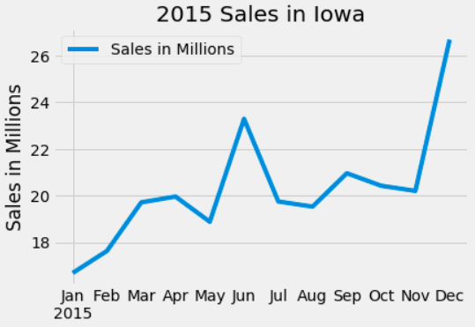
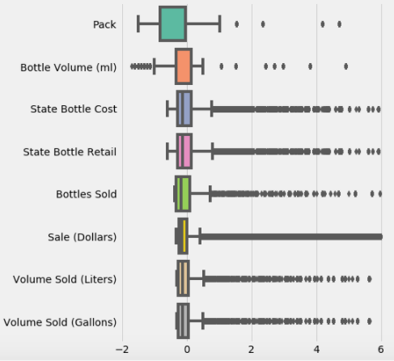
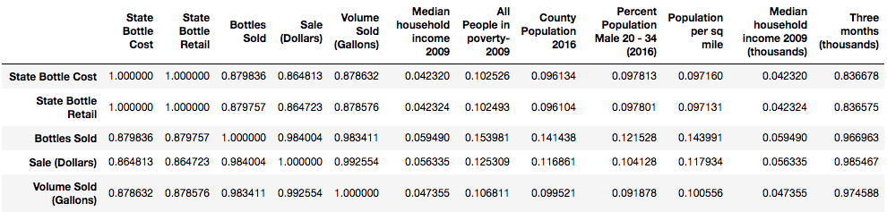
Predicting future sales
Iowa Liquor Sales
0.5% of observations (with data points more than 6 standard deviations from the mean) were dropped.
A variety of stores sell alcohol, for many, it is not their primary business. This explains much of the remaining variation.
91 stores without data for the first three months of the year. Loaded with 20th / 10th percentile statistics from other stores.
Correlations of (initial) Interest

Slide 4
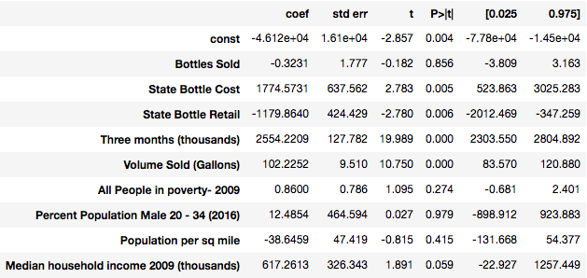
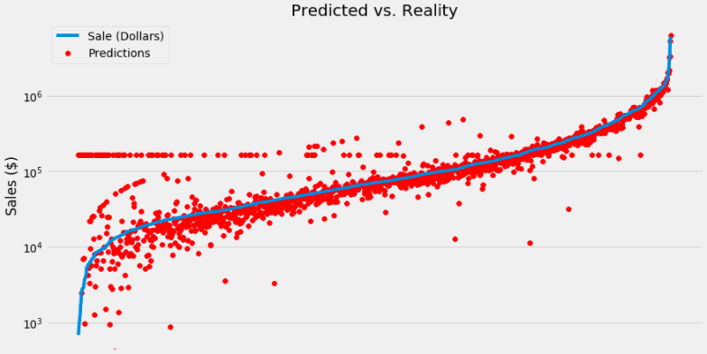
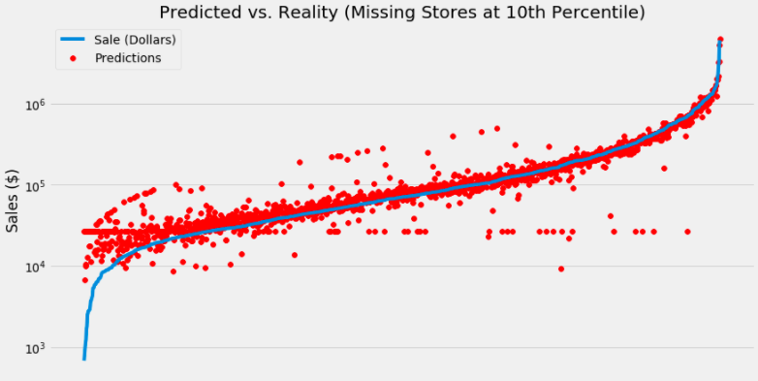


Predicting future sales
Iowa Liquor Sales
Full model: R^2 = 0.96
Reduced model
Reduced model (20th percentile): R^2 = 0.971
Clearly some concern that giving 20th percentile to stores with missing data was overly generous.
Changing to the 10th percentile may underweight a few, but provides an overall better fit.
Reduced model: R^2 (10th percentile) = 0.977

Slide 5
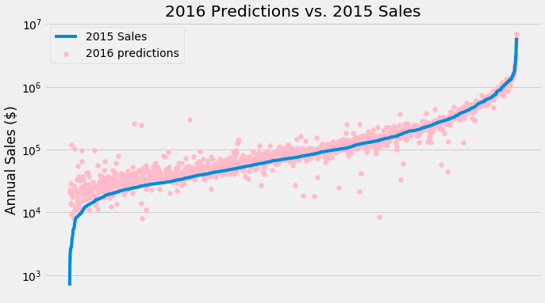
Predicting future sales
Iowa Liquor Sales
Plugging 2016 values into our basic OLS model returns $251.7 million.
This compares favorably with $243.6 million in sales from 2015.
Stores present in both datasets on average sold $2,900 more in the first three months of 2016 ($3.8 million more in total).
84 stores that didn’t have sales in the first three months of 2015 (but were created at the 10th percentile) did have sales in the first three months of 2016.
These stores, on average, sold $18,000 more than the same period in 2015. Suggesting they were new stores (not infrequent sellers).
Looking at only stores with authentic sales data in both periods, additional sales on average drop to $1800.
Assuming 60% (conservative estimate) of the number of stores that recorded sales after the first three months of the year again do so (at the 10th percentile in 2015 in total sales), we may hope to see another $1.6 million in revenues.
In total this would be a 3.98% increase in sales from 2015.

Slide 6
COUNTY BY COUNTY * Where are there opportunities for growth?
*Using only 10% of the full sample

Slide 7
Predicting the number of stores
County by County
Near perfect correlation between
the number of stores and population
measures.
Poverty Rate seems to have very little predictive power.
Population between 20-34 (a population that is historically probe to excessive alcohol consumption), Median household income 2009, and profitability per store all seem to be strongly correlated with number of stores without posing problems of multicollinearity or (obvious) reverse causality.

Slide 8
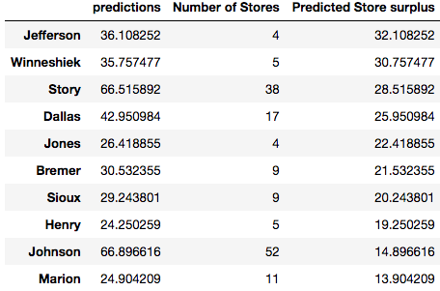
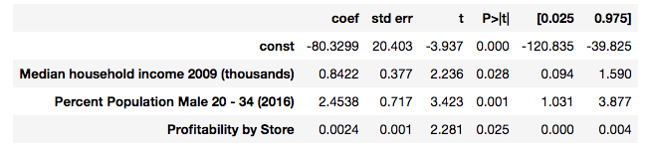
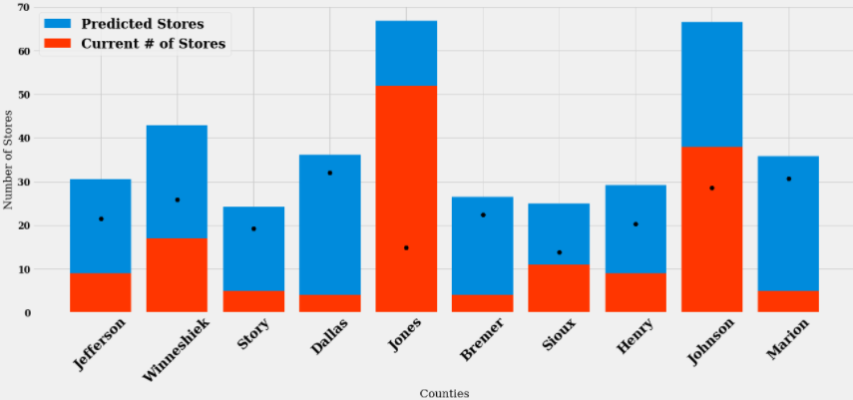
Predicting the number of stores
County by County
R-squared = 0.29
Mean Error = 20.95 stores
All variables significant at the 5% level. Profitability by store probably needs to be rescaled to be readily interpretable.
A 1000 dollar increase in median household income is associated on average with a 0.84 increase in the # of stores per count.
A one percent increase in the percentage of male population between 20-34 is associated with a nearly 2.5 store increase.

Slide 9
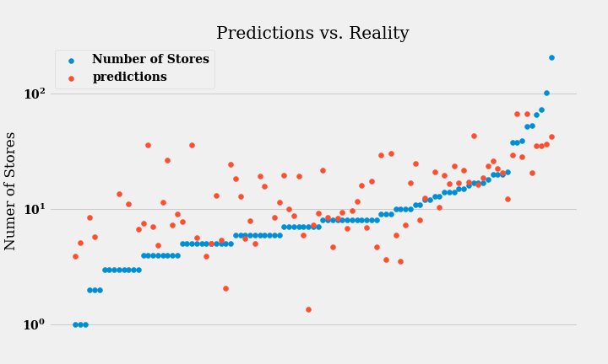
Predicting the number of stores
County by County
There seems to be a prediction issue for counties that currently have small numbers of stores.
This issues could be one of heteroskedasticity- i.e. that there is larger variance for smaller samples .
Now let’s take a look at logistic regression…

Slide 10
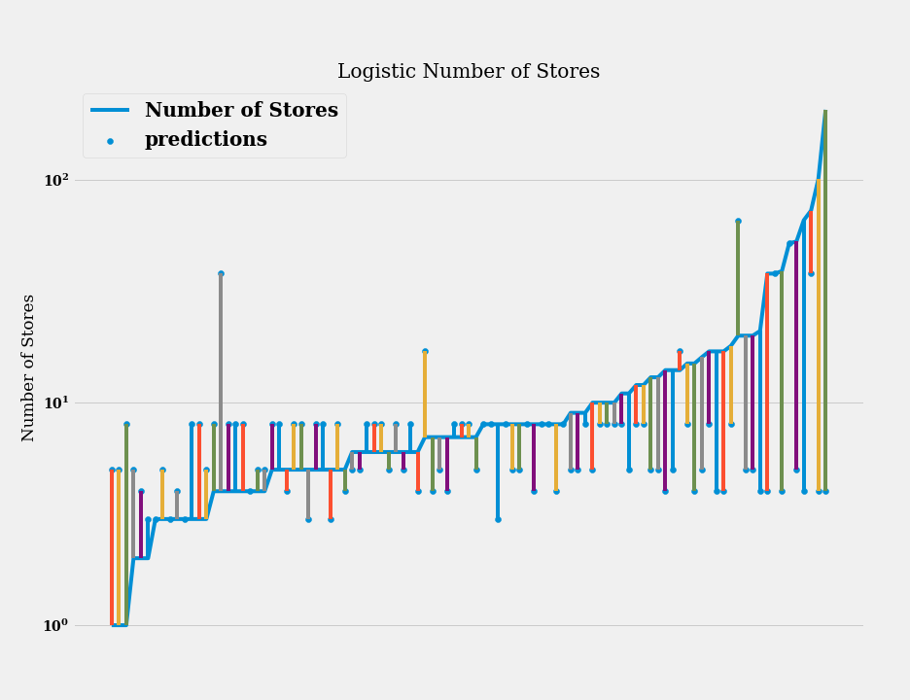
Predicting the number of stores
County by County
Same issue with correlation between error terms.
Accuracy of 13%.
Mean error is reduced to 9.4 stores. Eliminating the two largest miscalculations (of 203, 97), reduces the mean error to 6.5 stores. The mean number of stores is 13.9.
Now let’s take a look at profitability…

Slide 11
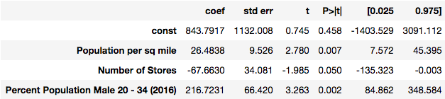
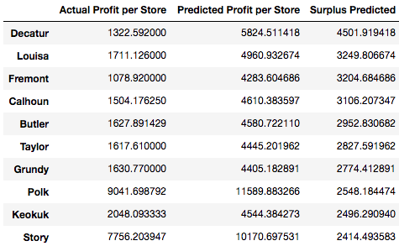
Predicting the profitability per store
County by County
R-squared = 0.32
Mean Error = $1938
.03 higher than previous model
All variables significant at the 5% level, except the constant. A insignificant constant means that if all other variables were 0, we could not rely on the constant being statistically different from 0– which makes sense!
Story county is the only count to appear in the top 10 of both lists (predicted to have 28 additional stores).
The mean profit/store is $5133, which makes the size of the mean error worrisome.

Slide 12
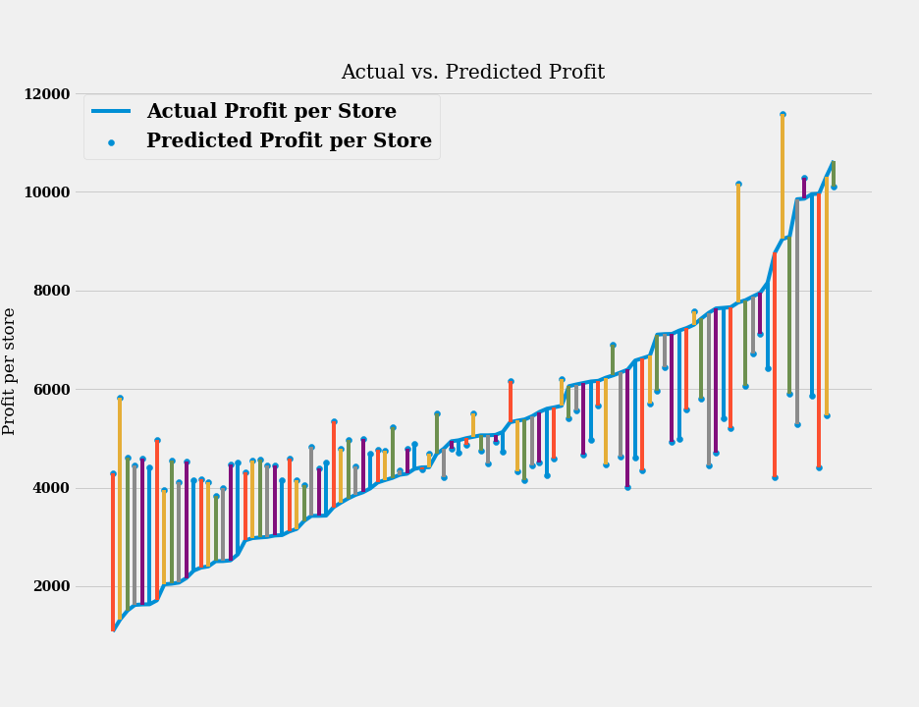
Predicting the profitability per store
County by County
The model is overestimating in counties where profits are currently small and underestimating in counties where current profits are high.

